Slide 1

12th December, 2020
Notes:
Thank you for coming!

Slide 2





DDD 2020! Welcome
Be aware of others
Be friendly and patient
Be welcoming and respectful
Be open to all questions and viewpoints
Be understanding of differences
Be kind and considerate to others
For our full Code of Conduct or to report an issue, go to:
https://bit.ly/DDDCofC

Slide 3

Donate!
https://www.justgiving.com/fundraising/developerday2020

Slide 4








Sponsors!
Notes:
Thank them
Microsoft – giveaways!
Black Marble – organisation/volunteers
Donations!
iO Associates, Grey Matter, NDC London (25-29 January 2021)

Slide 5

Make it Social! Tweet!
#DDD2020
@developerday
Enjoy your day!

Slide 6
Building and Extending a Published Intranet in SharePoint Online
and Making it Available in Teams

Slide 7





Andy Dawson
MVP (Office Apps and Services
@W4050
https://github.com/Andy-Dawson

Slide 8
You Will Need…
An Office 365 tenant
A development environment
SPFx web part samples
Microsoft Teams with App Studio installed
Be an Office 365 Admin
(Almost) all of which we’ll cover in this session

Slide 9
The Process
Create a SharePoint Communications site for use as a published intranet
Swap into root site collection if needed
Look at the sample custom web parts available to extend functionality
Get your tenant ready to deploy apps
Get your development environment ready
Clone sample repo, compile and test web part in SharePoint workbench
Package and deploy the app, then use it on the Communication site
Create Teams App and test, then pin the app in Teams
Can use for classic and modern and non-SP pages

Slide 10
Developer Tenant
If you don’t have an Office 365 tenant…
Or you want to try this in an isolated tenant
You can get a developer tenant for free by signing up at https://developer.microsoft.com/office/dev-program
Full E5 SKU with 25 users, free for ~90 days
This is extended automatically if you use the tenant for development

Slide 11
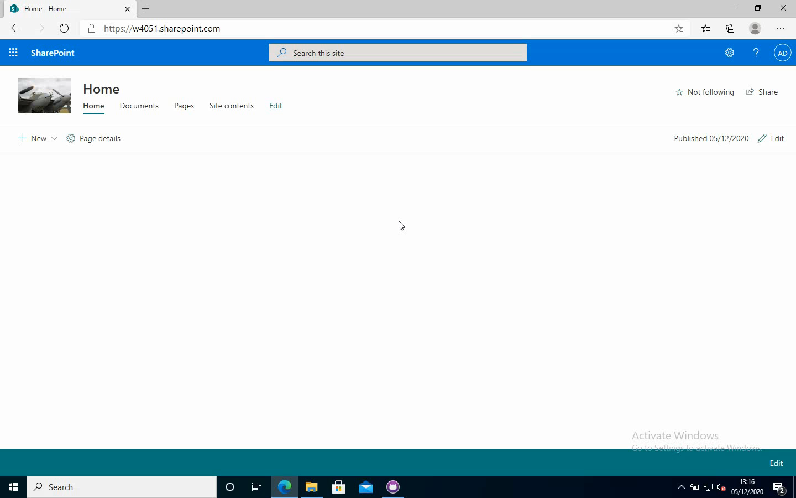
SharePoint Communication Site

Slide 12
If you Have an Older Tenant…
You can replace the original classic team site at the root of SharePoint with a modern Communication site
The process:
Create a new Communication site on another URL (e.g. /sites/CommunicationSite)
Install the SharePoint Online Management Shell Module
Invoke-SPOSiteSwap -SourceUrl https://domain.sharepoint.com/sites/CommunicationSite -TargetUrl https://domain.sharepoint.com -ArchiveUrl https://domain.sharepoint.com/sites/Archive

Slide 13
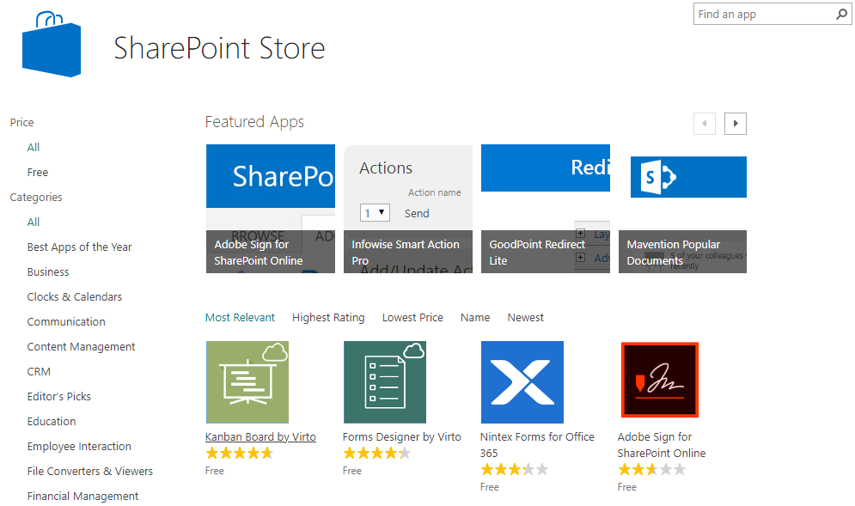
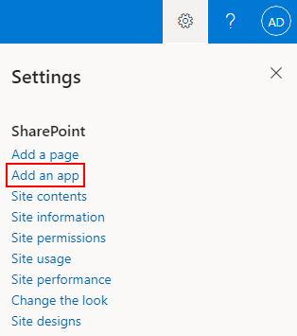
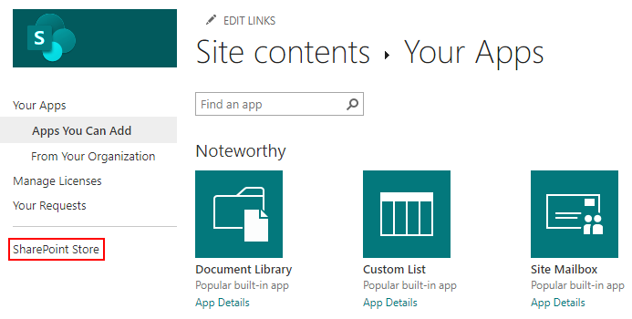
What About Additional Functionality?
What do we do if the in-box web parts don’t cover everything we want to add to our SharePoint page?
Add an app from the store

Slide 14
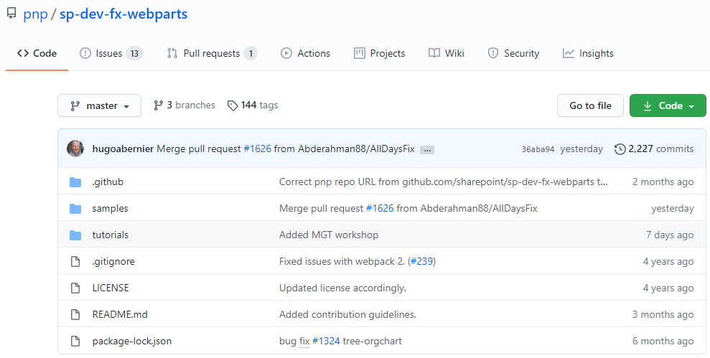
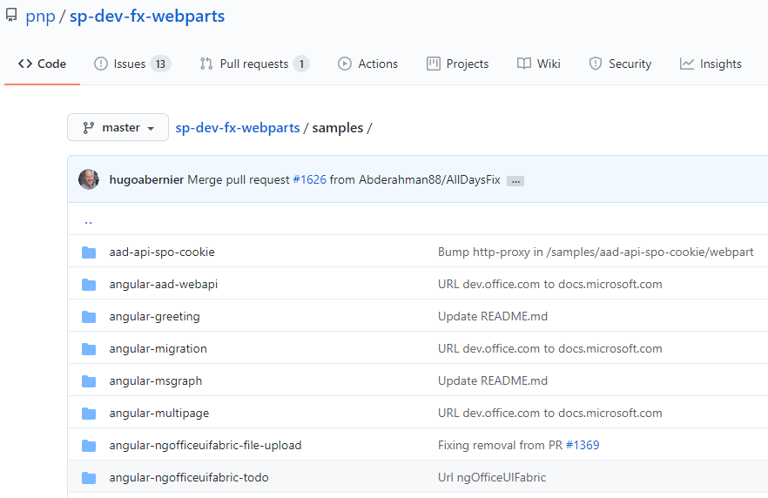
But There’s More…
You can always create your own!
There are LOTS of samples available
Have a look at https://github.com/pnp/sp-dev-fx-webparts

Slide 15
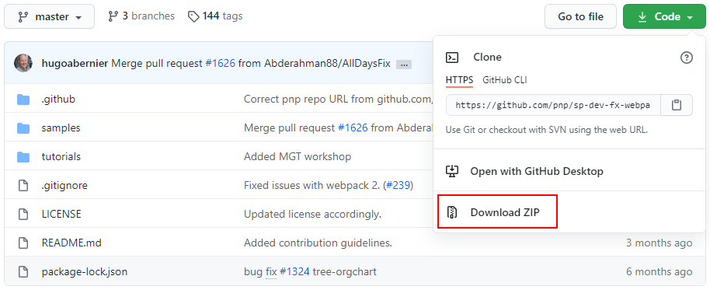
Download the Samples
Git clone (command line or GitHub Desktop etc.)
… Or just download the zip file

Slide 16
Ready Tenant to Deploy Apps
Follow the instructions at https://docs.microsoft.com/en-us/sharepoint/dev/spfx/set-up-your-developer-tenant
In a nutshell:
Create an App Catalog
Create a site collection for testing (optional)
Find the URL for your SharePoint Workbench (https://domain.sharepoint.com/_layouts/workbench.aspx)

Slide 17
Configure Development Environment
Follow the instructions at https://docs.microsoft.com/en-us/sharepoint/dev/spfx/set-up-your-development-environment
In a nutshell:
Install Node LTS 10.x from https://nodejs.org/en/download/releases/ (later versions not supported at this time)
Install a code editor – I use VS Code - https://code.visualstudio.com/
Run the following from an admin command prompt/PowerShell: npm install gulp yo @microsoft/generator-sharepoint --global

Slide 18
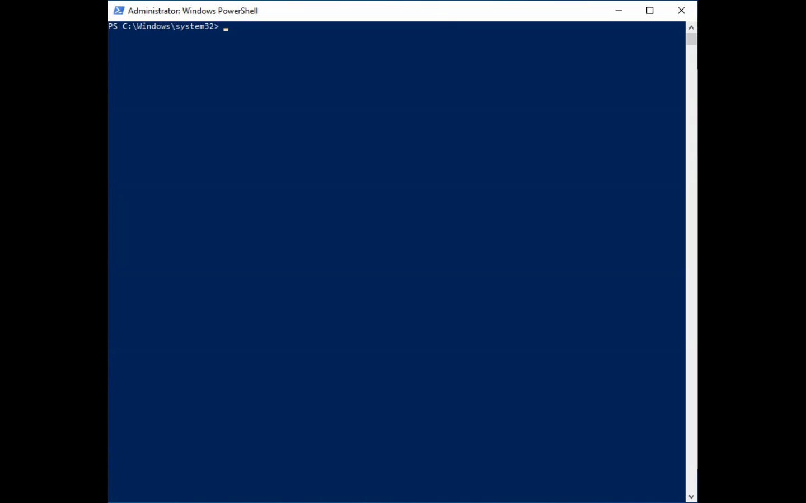

Slide 19
Compile & Test Sample App
Pick an app from the sample list we pulled down previously
I’m using ‘react-rss-reader’ for this session
There are LOTs available and the list is being updated frequently

Slide 20
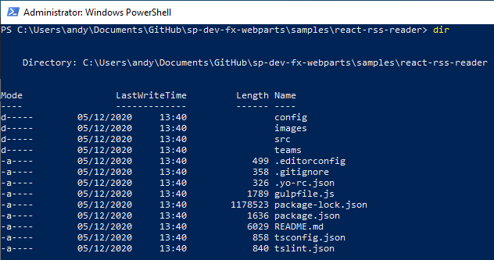
Looking at the Sample App
Notes:
Using PowerShell to have a look at the folder containing the sample app we’re using.

Slide 21
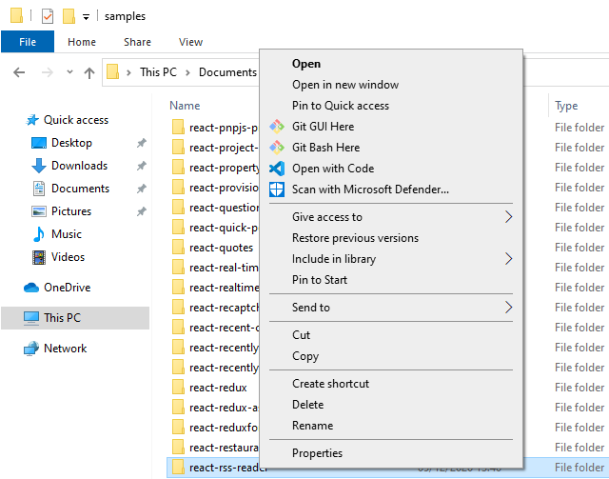
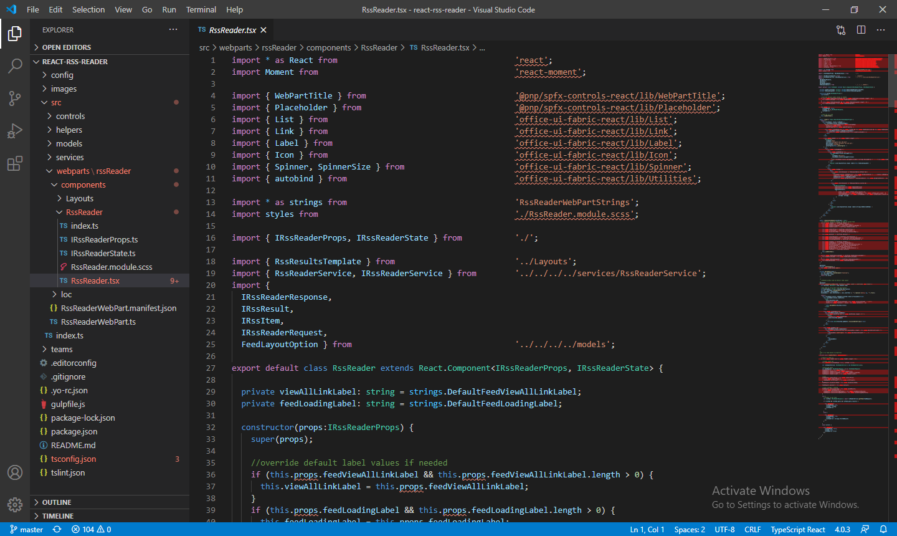
… And Using Visual Studio Code
Notes:
Lots of errors shown in VS Code – we’ll address these in a moment!

Slide 22
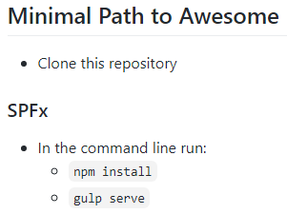
Minimal Path to Awesome
We’ve already cloned the repo/downloaded the zip file and unpacked it
Run the following commands from the PowerShell window we looked at a moment ago:
npm install
gulp serve

Slide 23
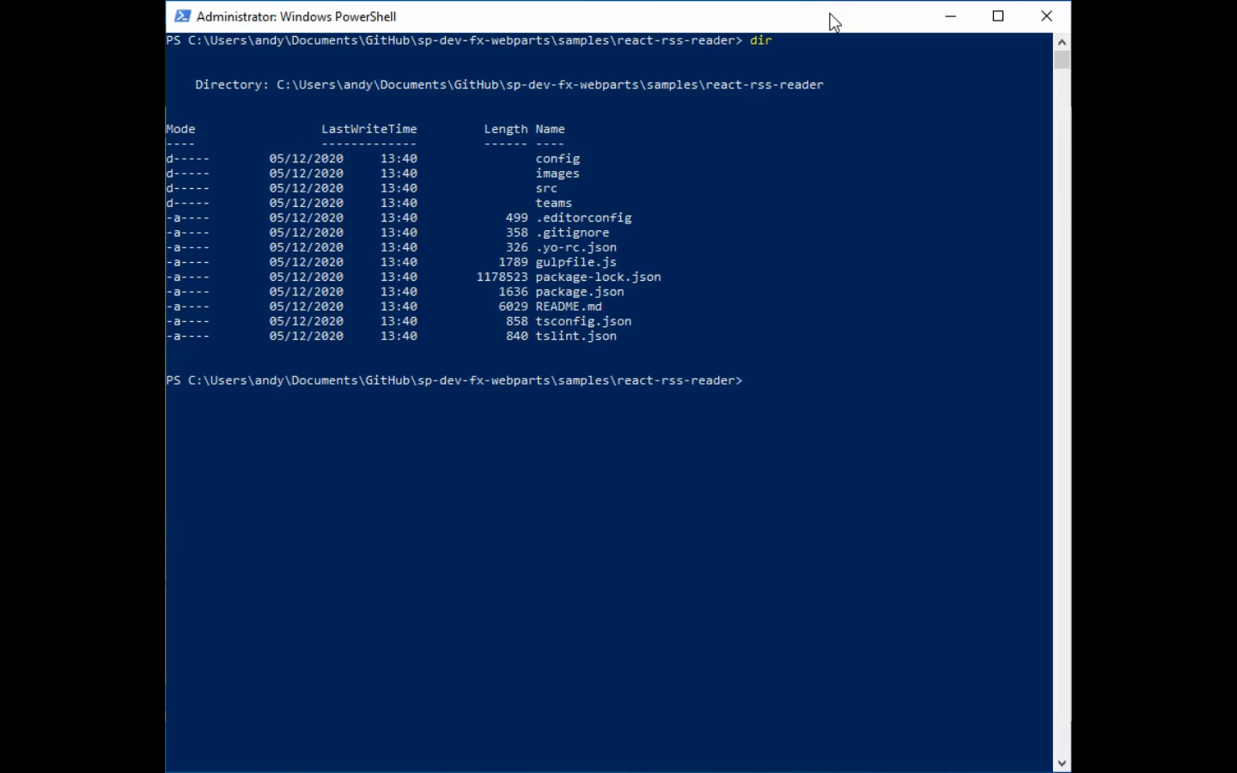
Notes:
Running ‘npm install’ inside the folder containing the app we want to compile
This is 5x speed as it takes a while (about 3 minutes)

Slide 24
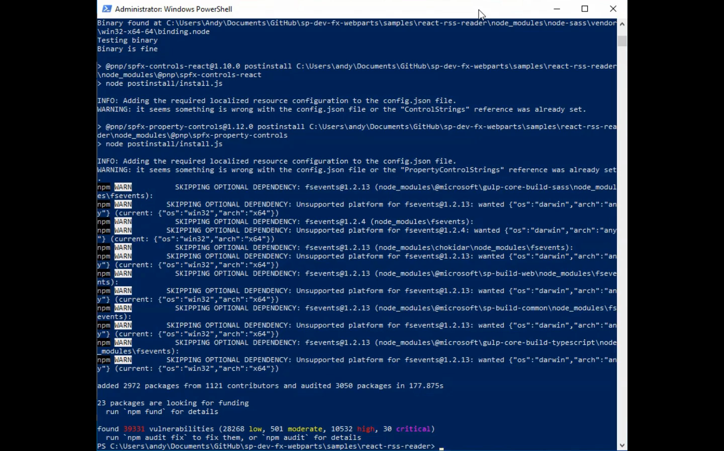

Slide 25
Errors and Solutions
Set-ExecutionPolicy Unrestricted
gulp trust-dev-cert
You’ll see a security warning about installation of a certificate, click ‘Yes’ to install the certificate

Slide 26
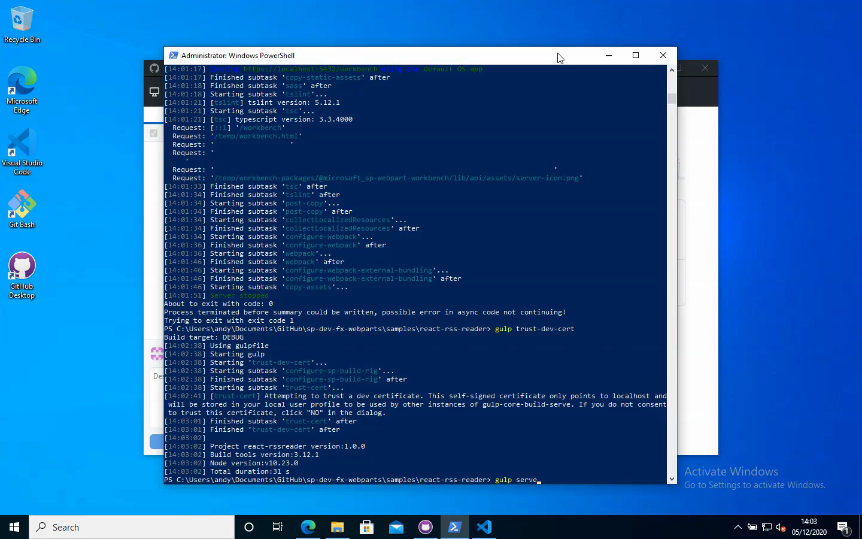

Slide 27
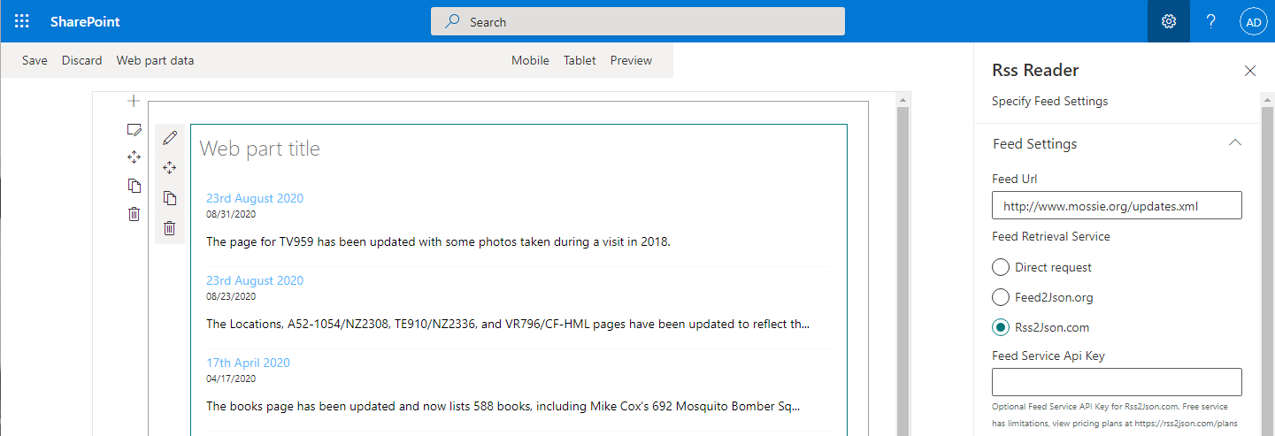
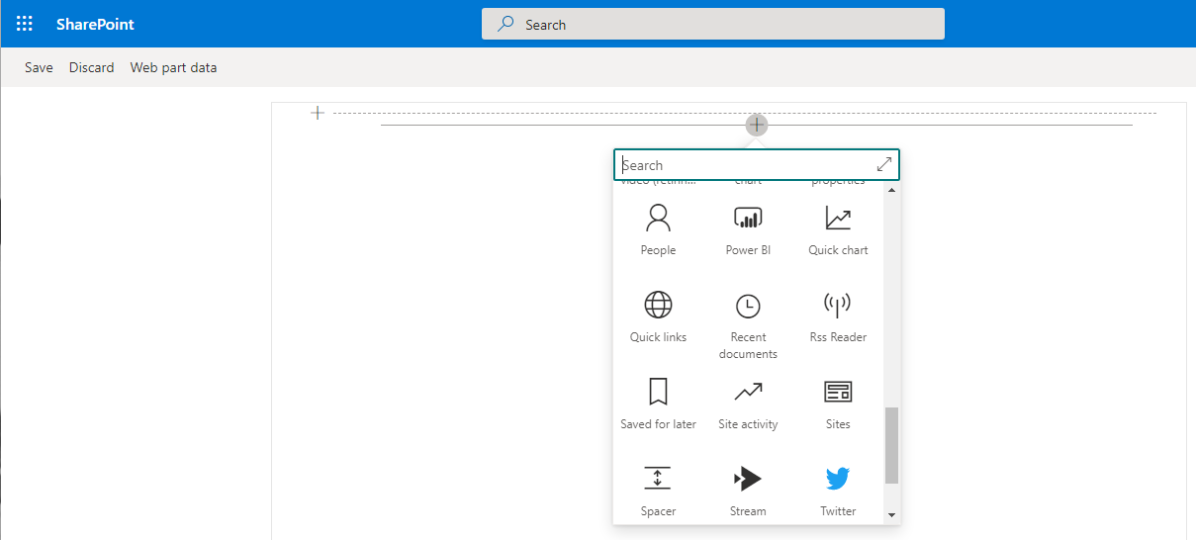
Online Workbench
If you’re testing a sample that needs to access SharePoint, use the Online Workbench
https://domain.sharepoint.com/_layouts/workbench.aspx

Slide 28
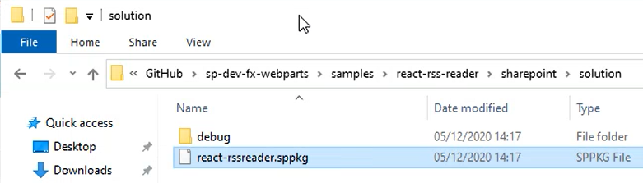
Package & Deploy Sample App
Use the following commands to package the sample app:
gulp bundle --ship
gulp package-solution --ship
An ‘sppkg’ file will be created in /sharepoint/solution under your current folder.

Slide 29
Deploy the App to Your App Catalog
Navigate to your App Catalog in SharePoint Online
Click ‘Apps for SharePoint’ at the left
Drag and drop your ‘sppkg’ file into the App Catalog
Trust the solution

Slide 30
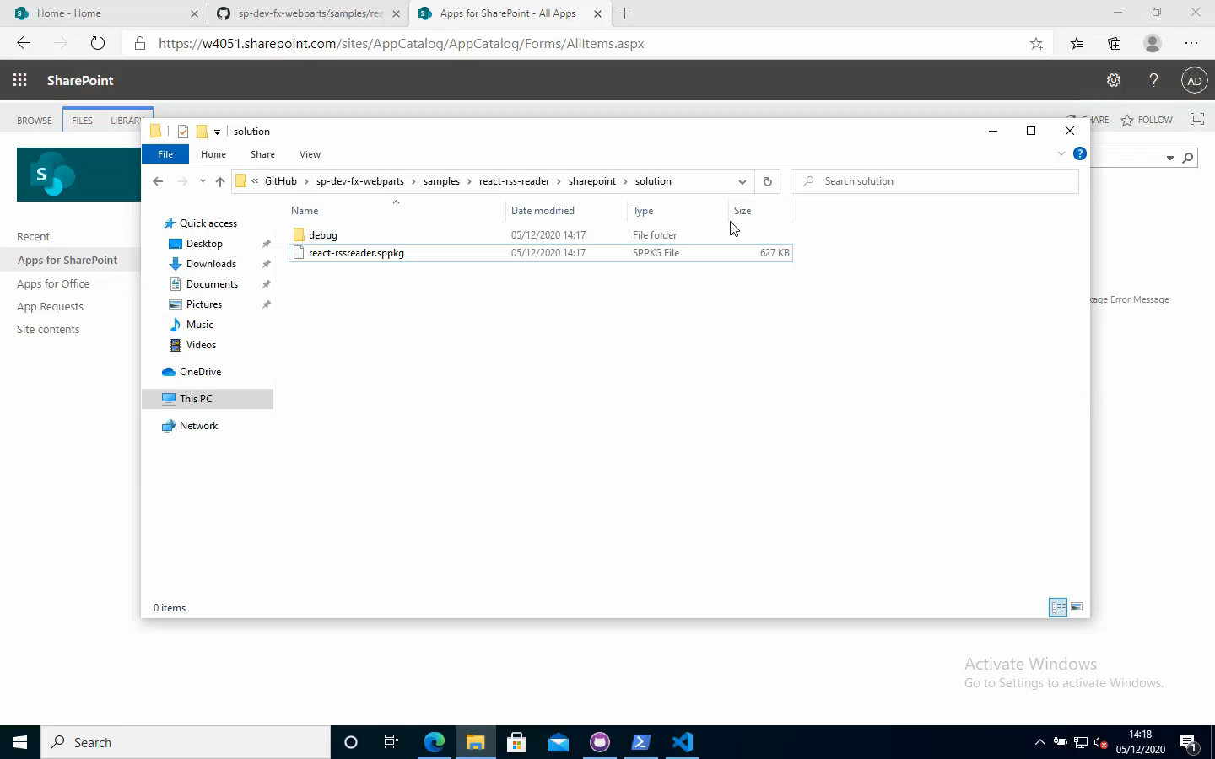

Slide 31
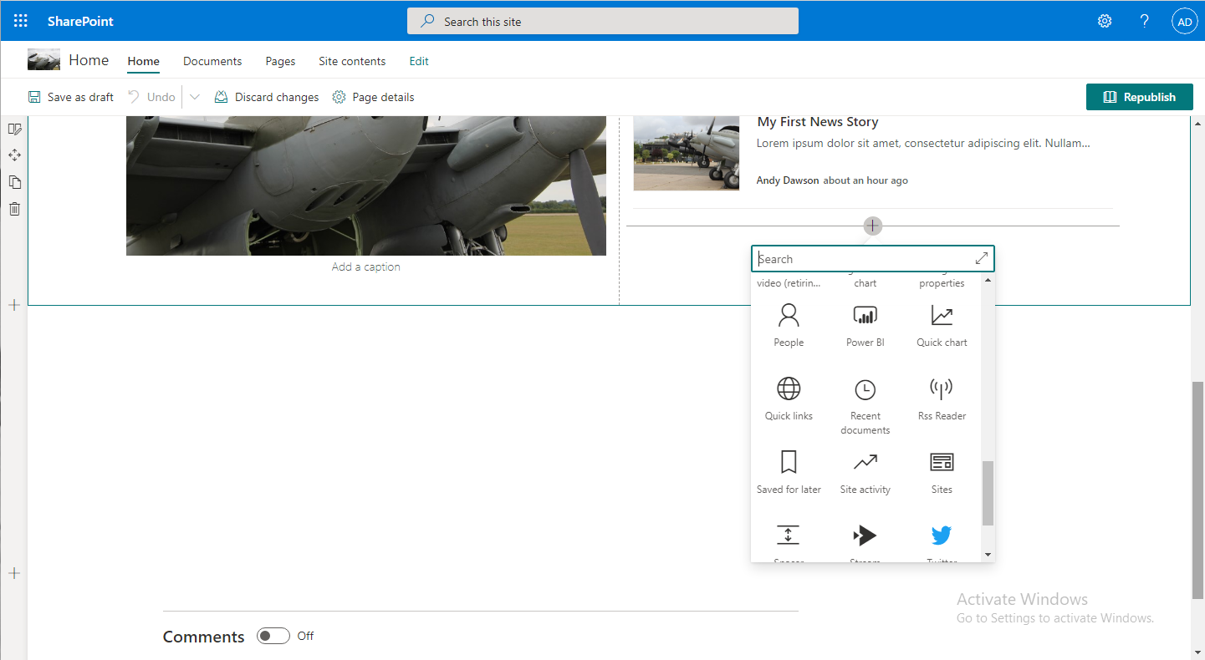
Add Our Custom App to a Page

Slide 32
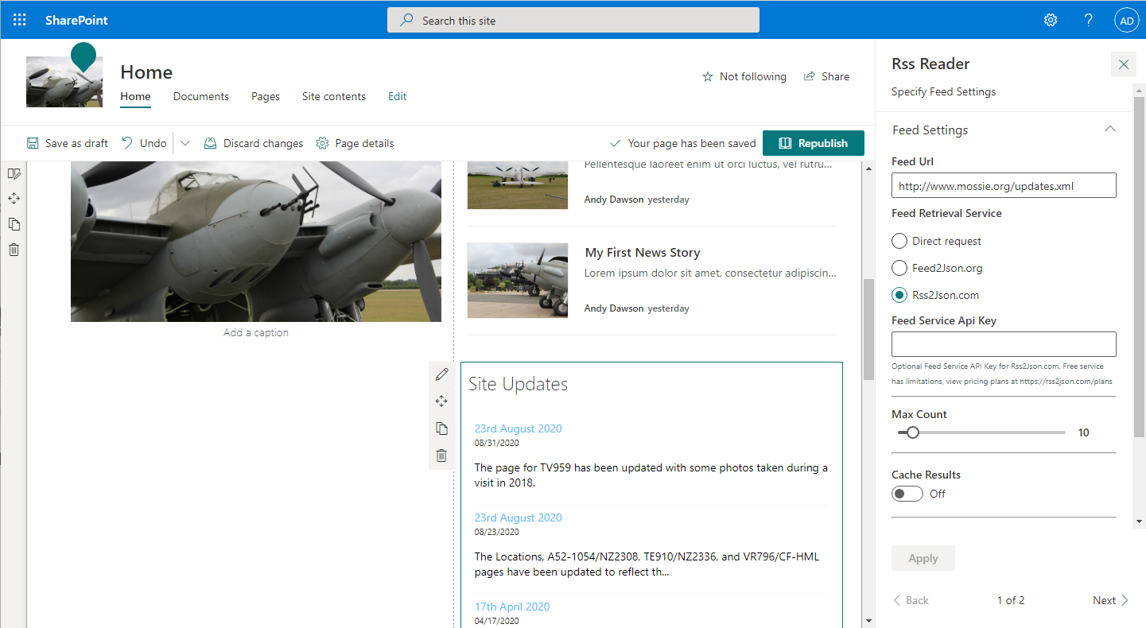
Configure the App
Notes:
Remember to republish the page once finished with the configuration

Slide 33
Prep to Create the Teams App
Install App Studio in Teams
Um… That’s it

Slide 34
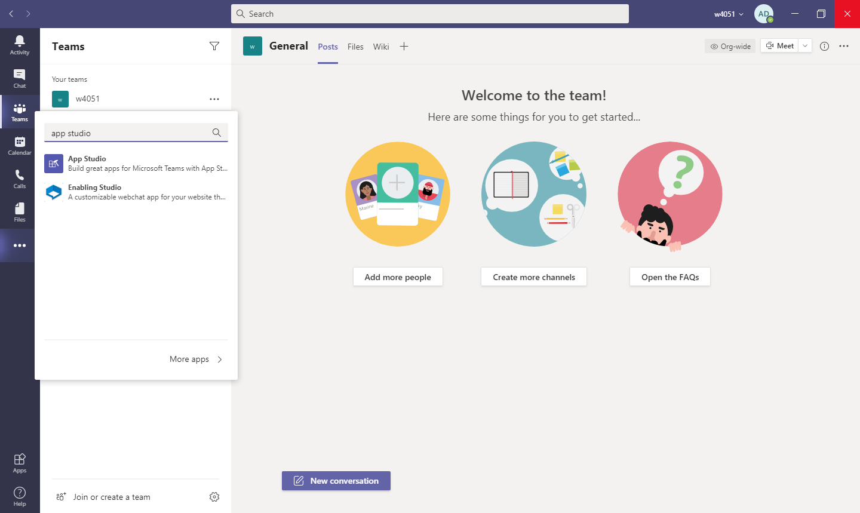

Slide 35
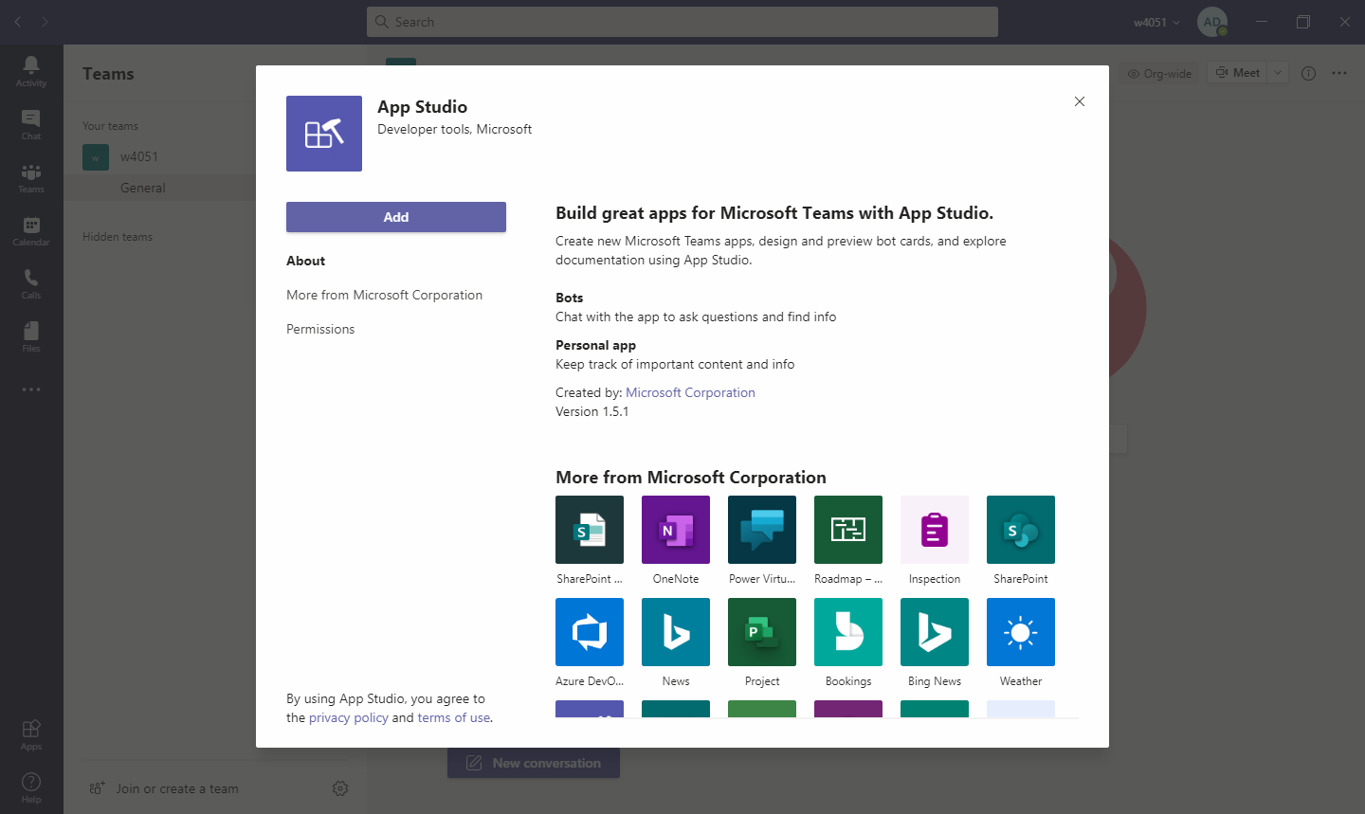

Slide 36
Create an App in App Studio in Teams
Follow the instructions at https://docs.microsoft.com/en-us/sharepoint/dev/features/embed-pages-to-teams
Start Teams App Studio
Select ‘Manifest Editor’
Create a new app
Fill in the app details
Select a full colour logo, a transparent outline and the accent colour
Select ‘Tabs’
Add a personal tab and complete the details
Select ‘Domains and Permissions’ and ensure permissions are correct
Select ‘Test and Distribute’ and click Install to see what it looks like

Slide 37
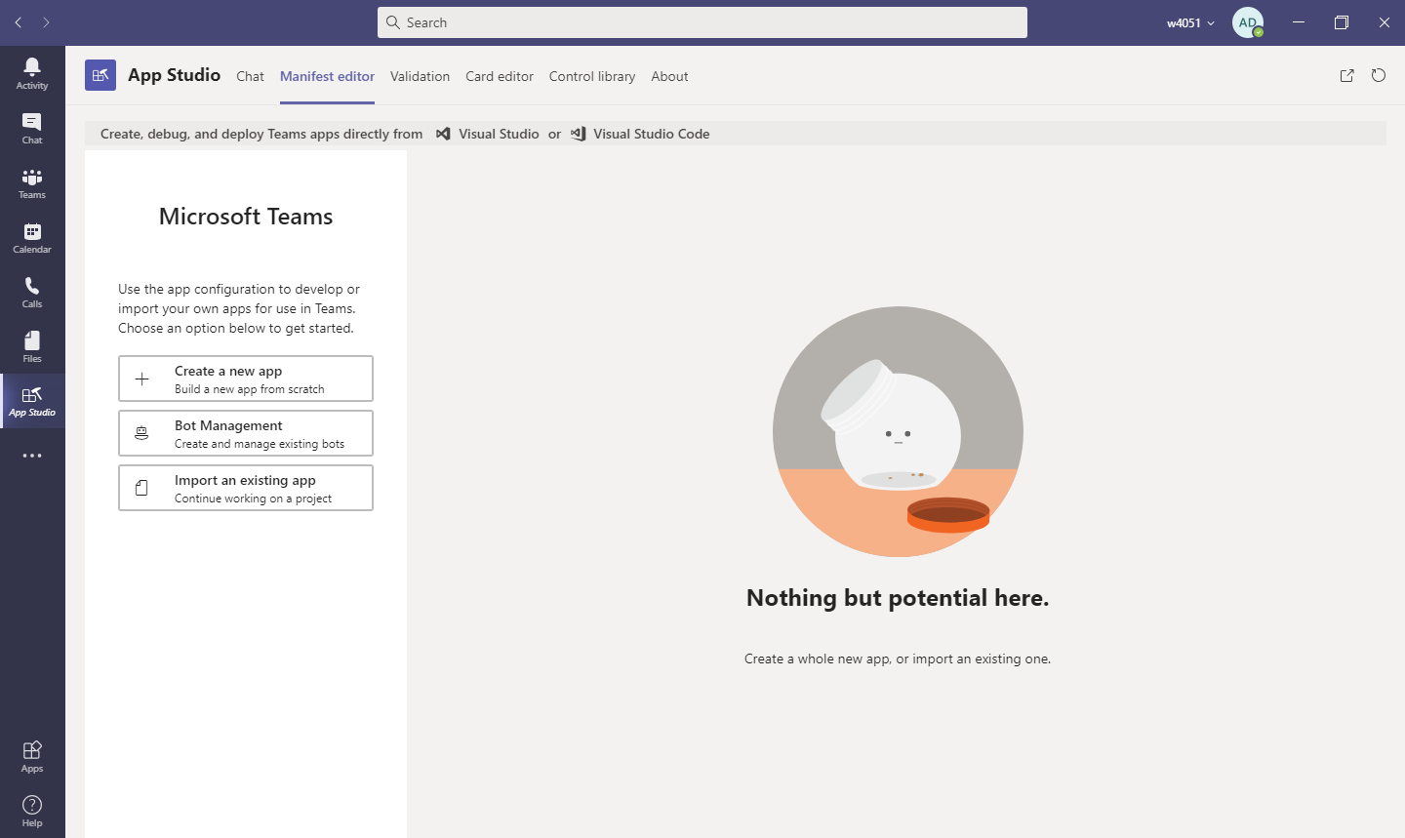

Slide 38
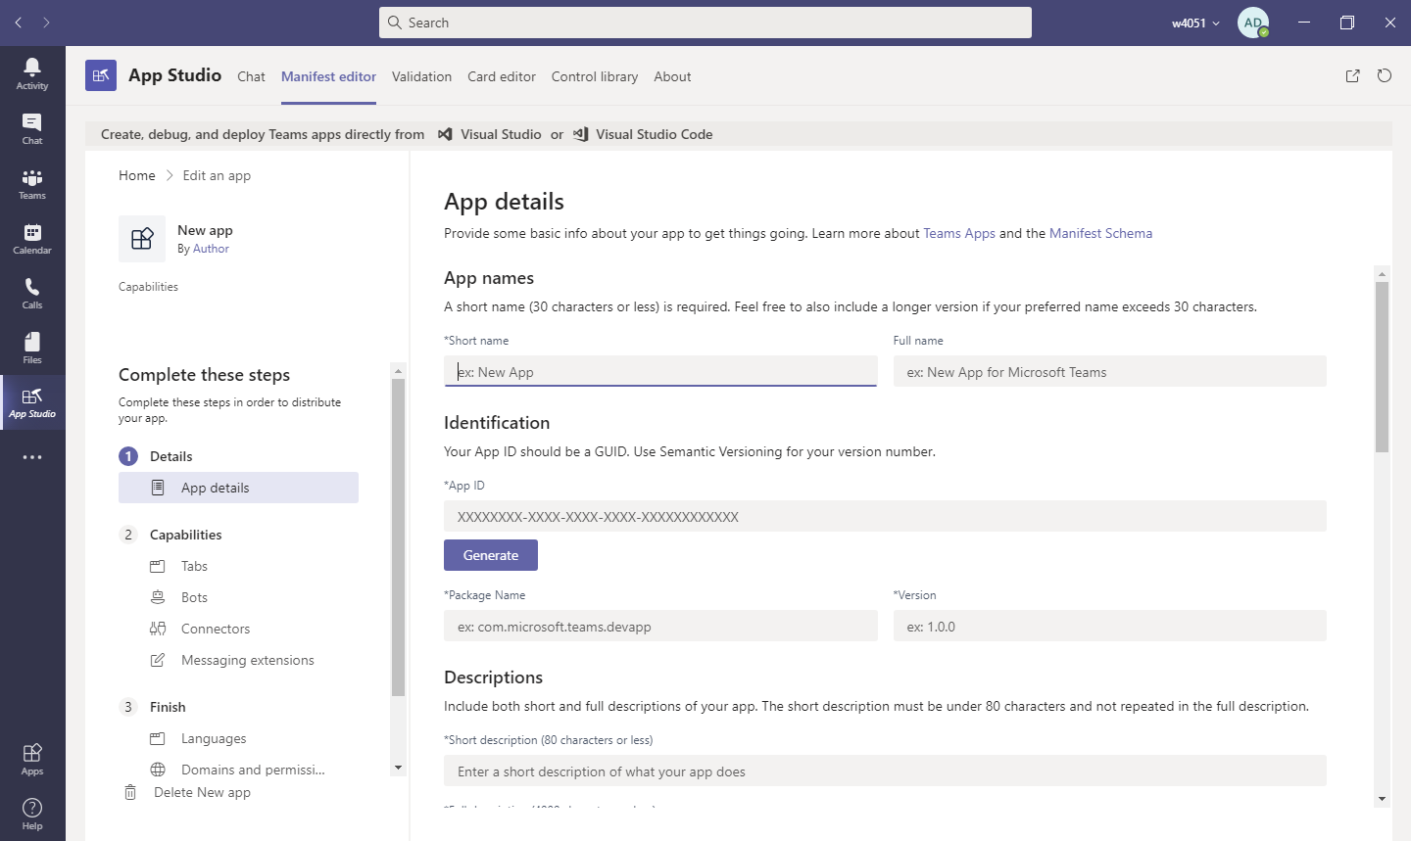

Slide 39
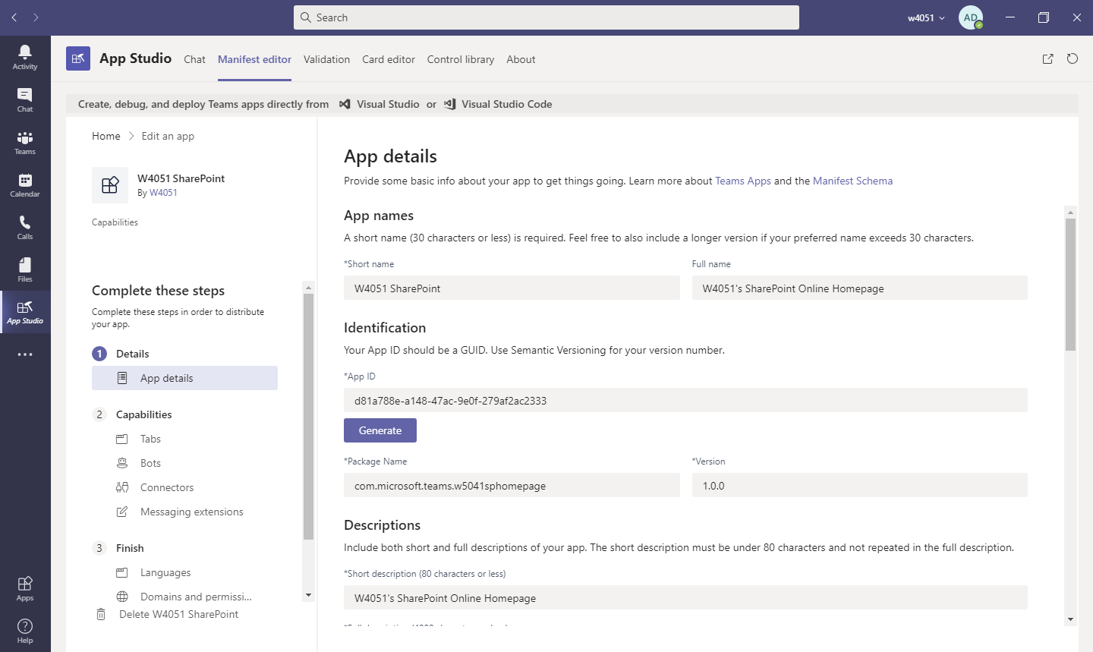

Slide 40
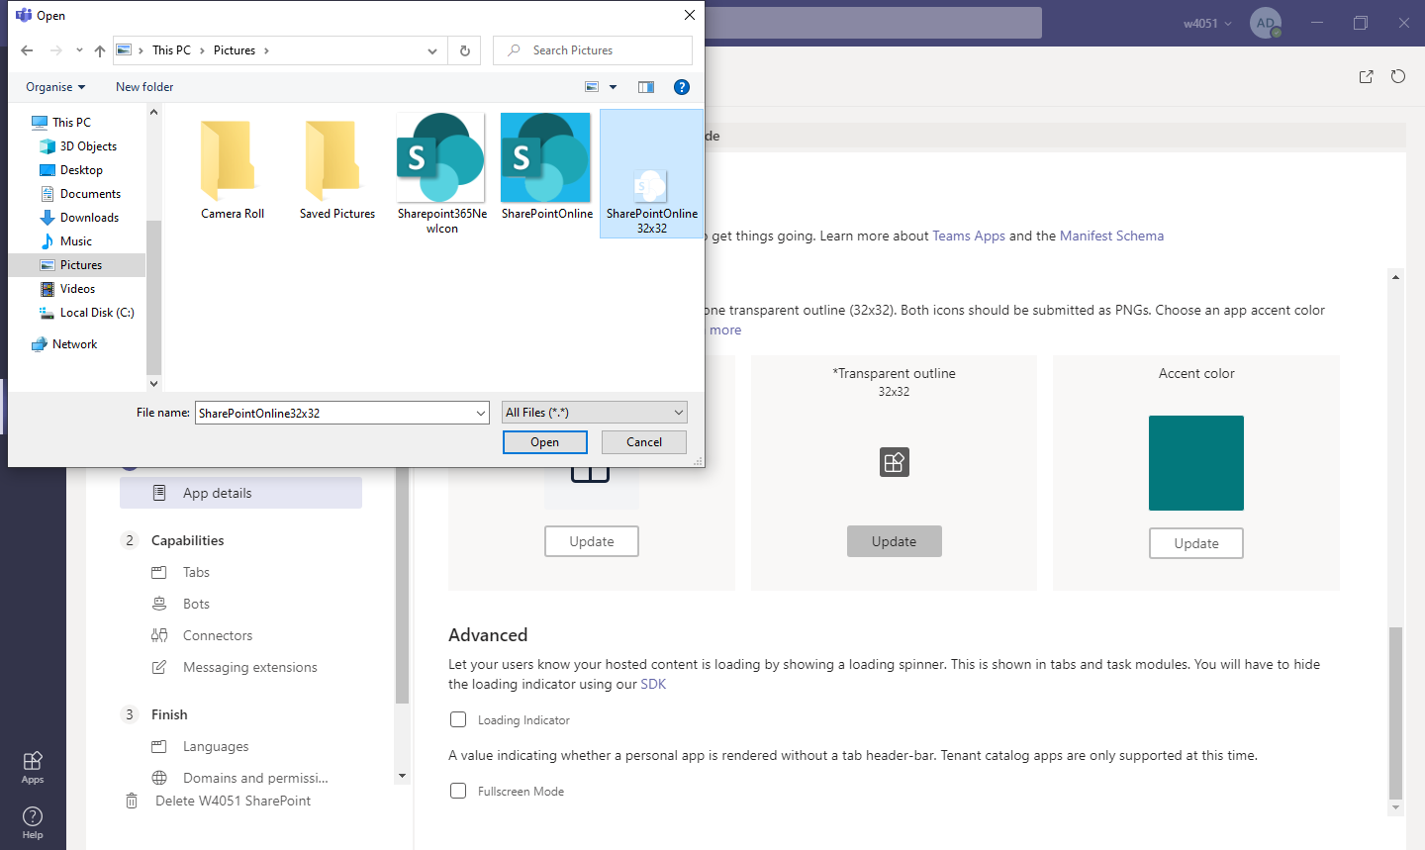

Slide 41
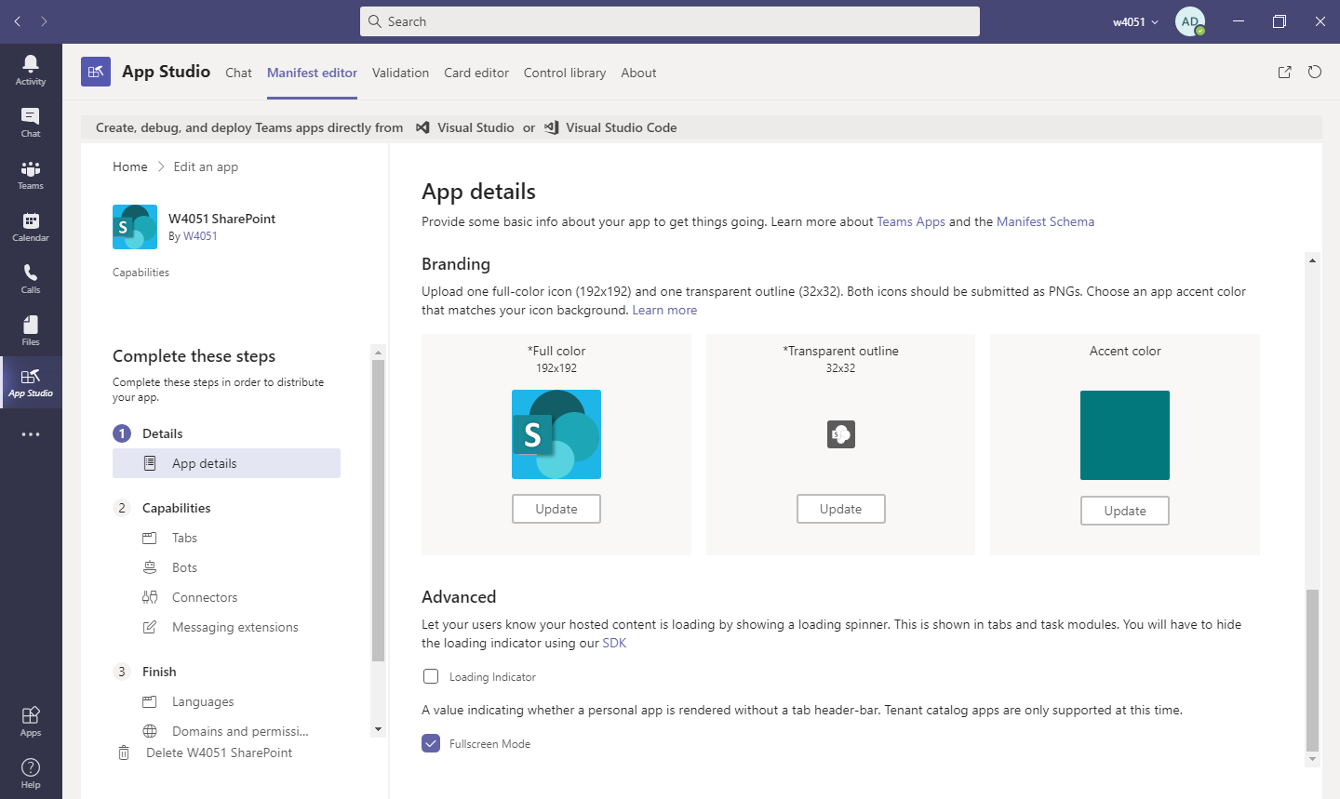

Slide 42
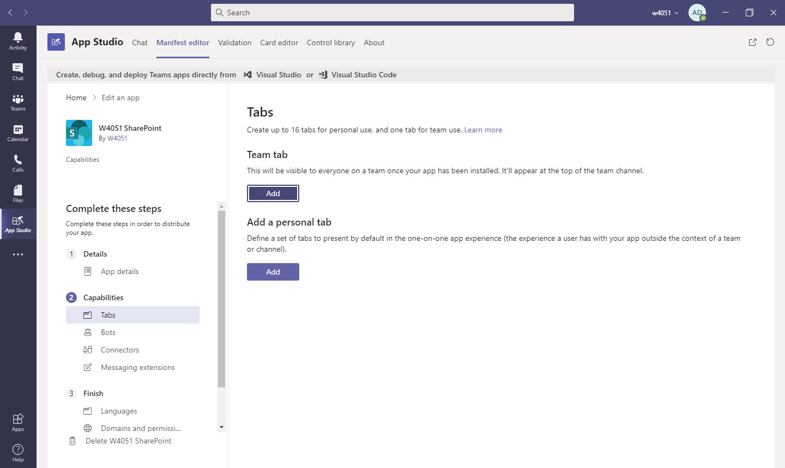

Slide 43
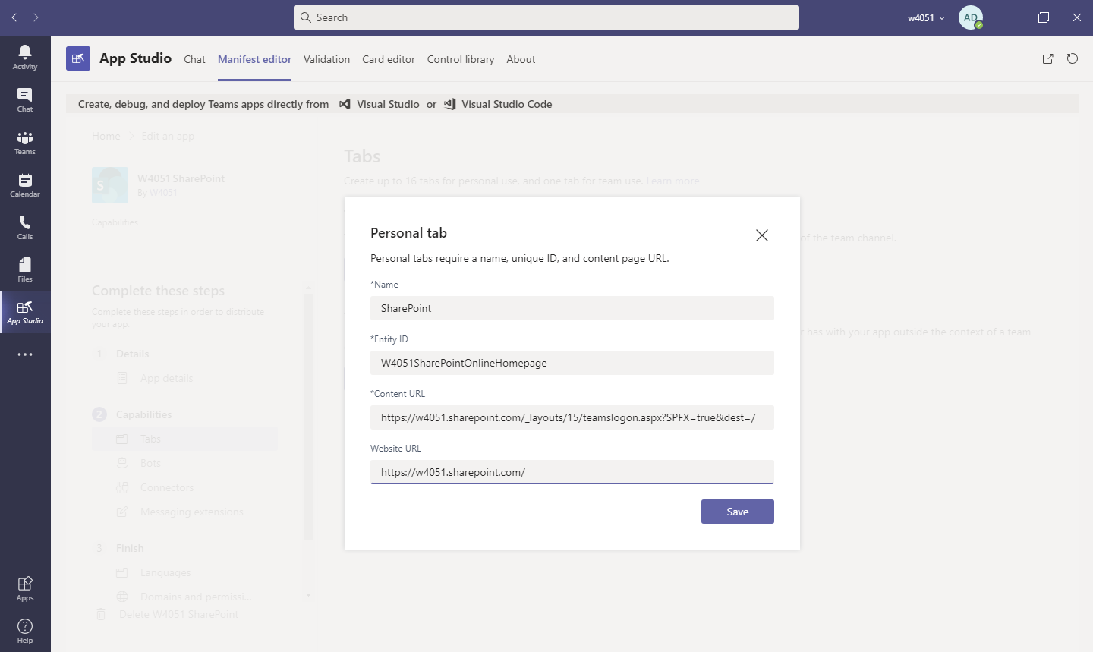

Slide 44
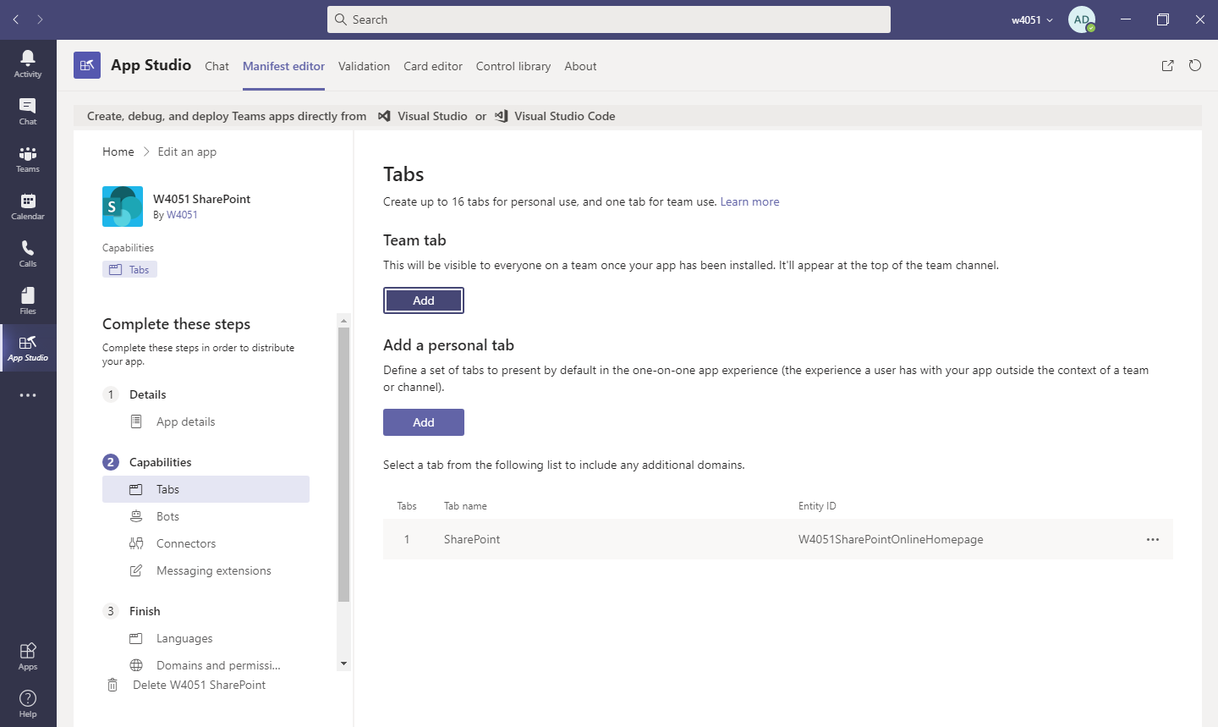

Slide 45
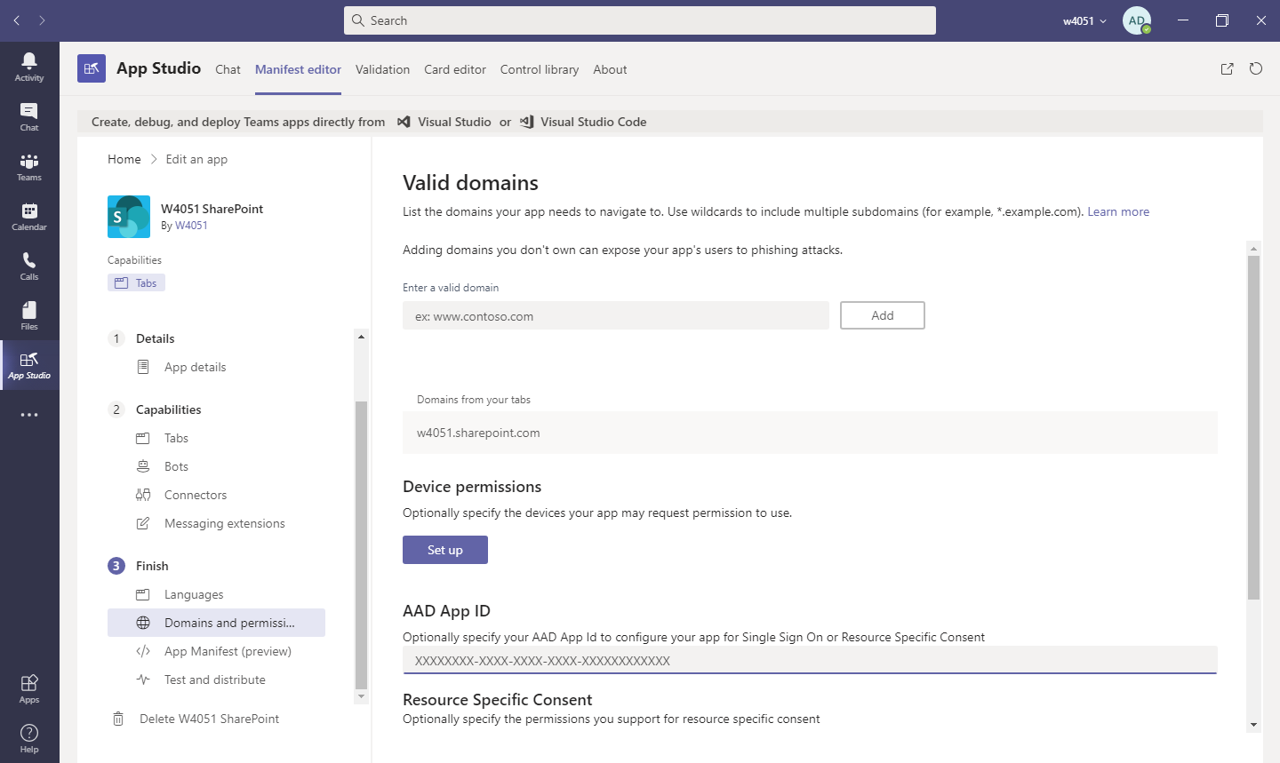

Slide 46
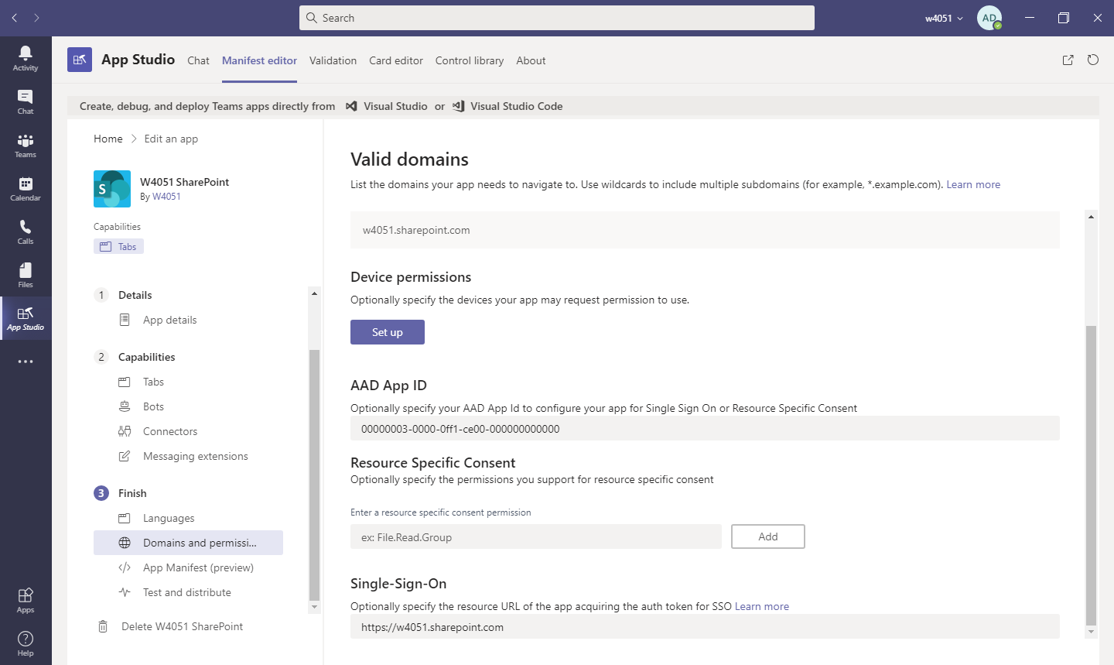

Slide 47
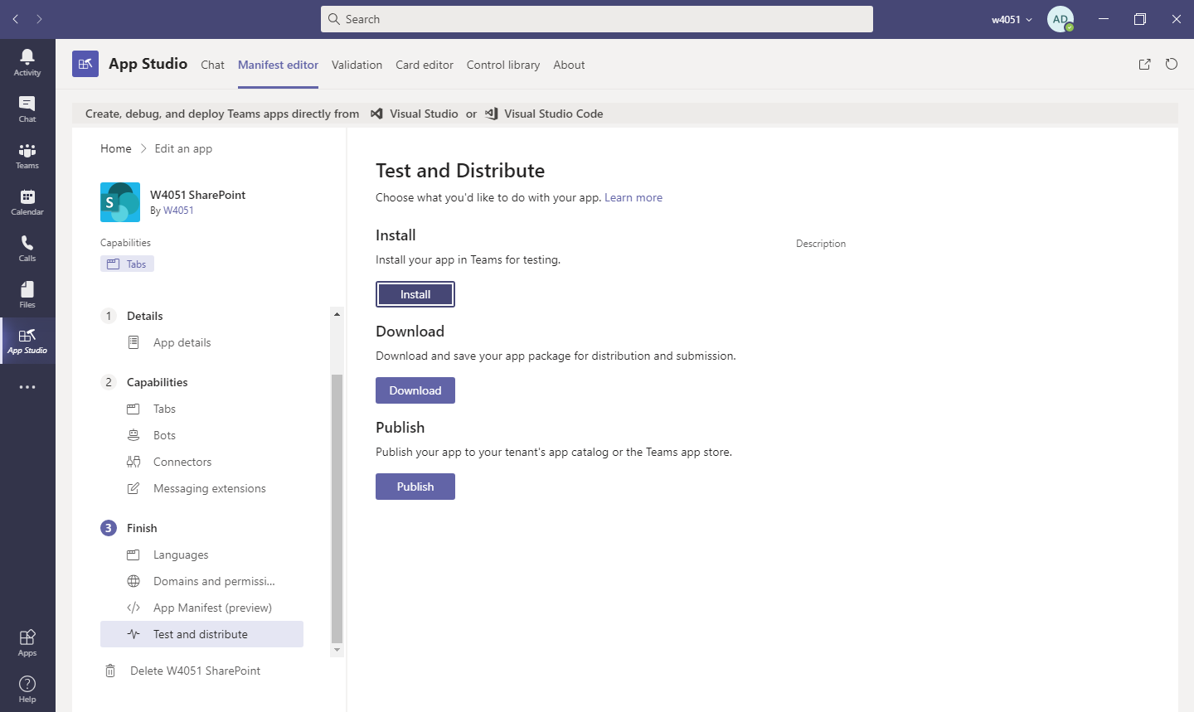

Slide 48
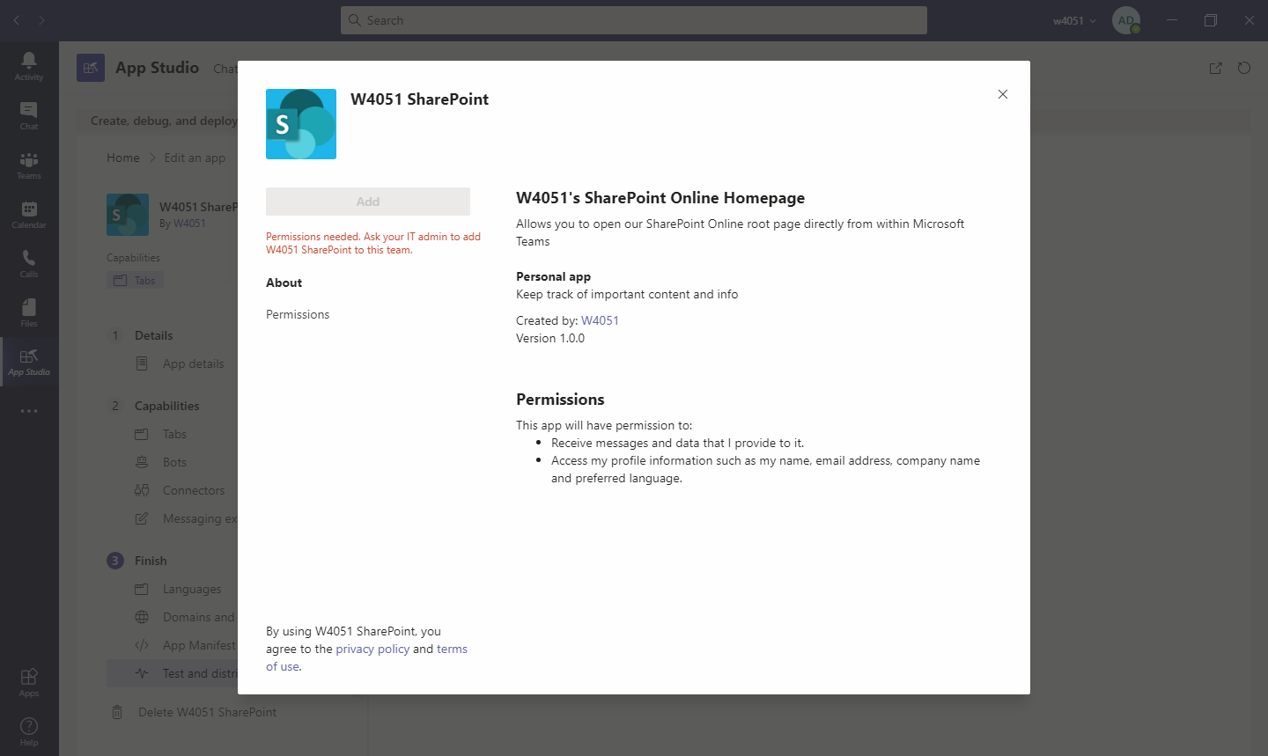

Slide 49
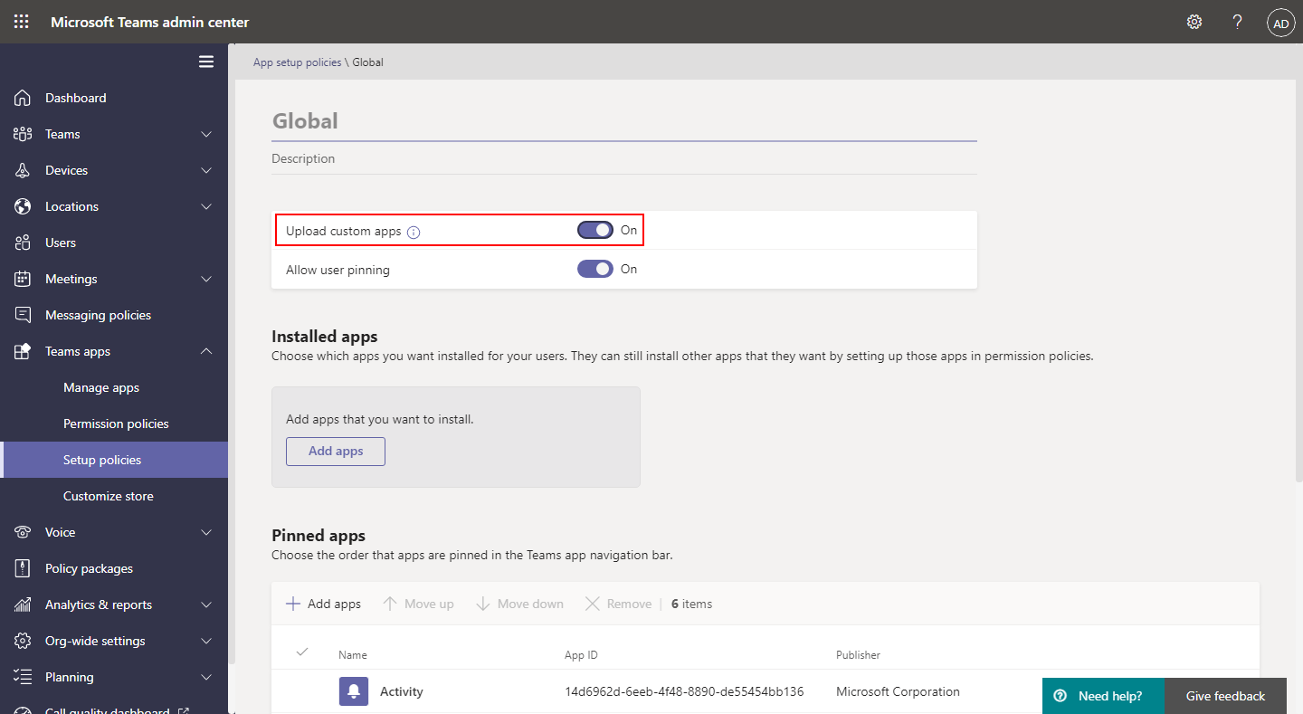

Slide 50
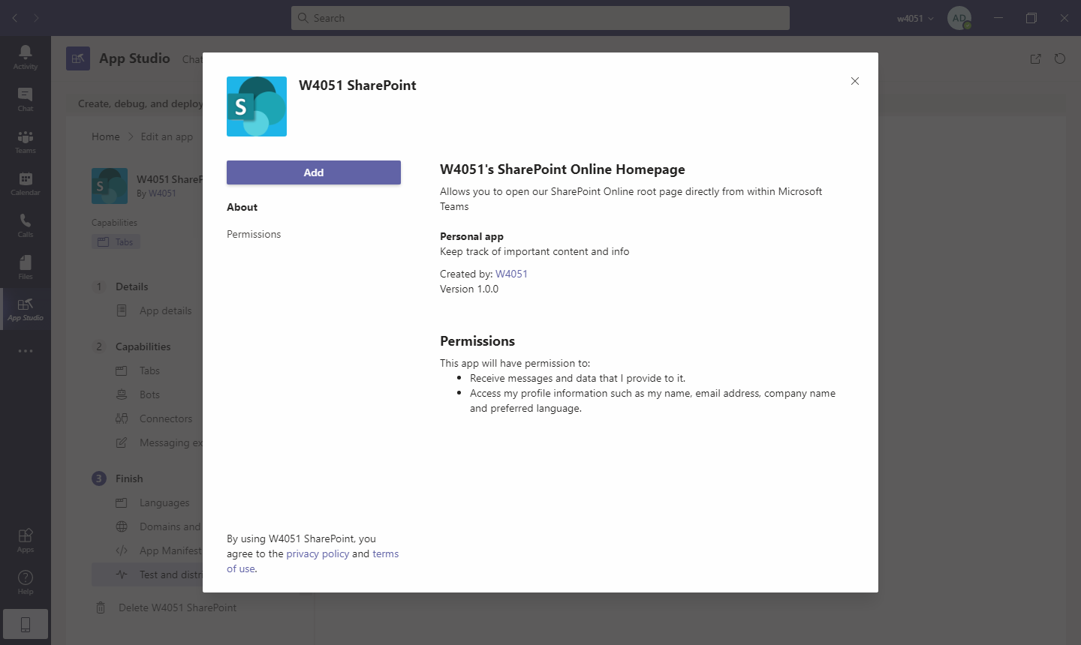

Slide 51
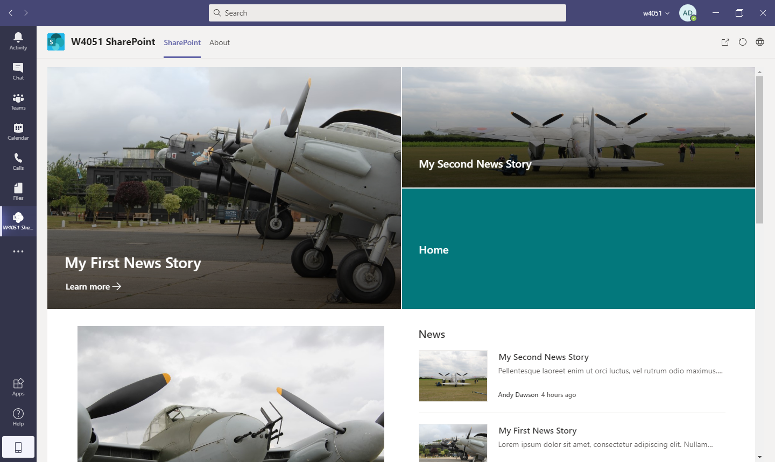

Slide 52
Add the App to Teams and Pin It!
Download the App
Upload it into the Teams Admin Centre
Use a Setup Policy to automatically pin the app for all users

Slide 53
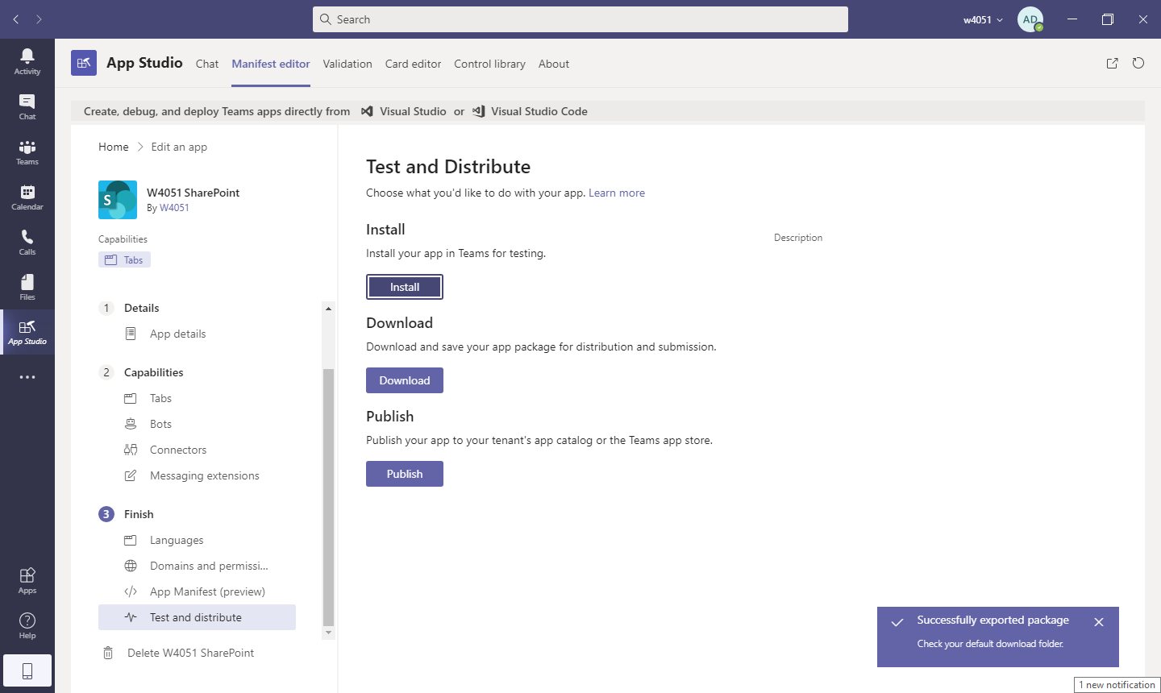

Slide 54
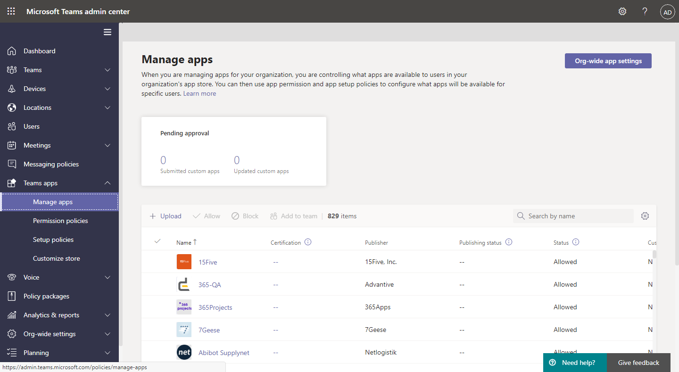

Slide 55
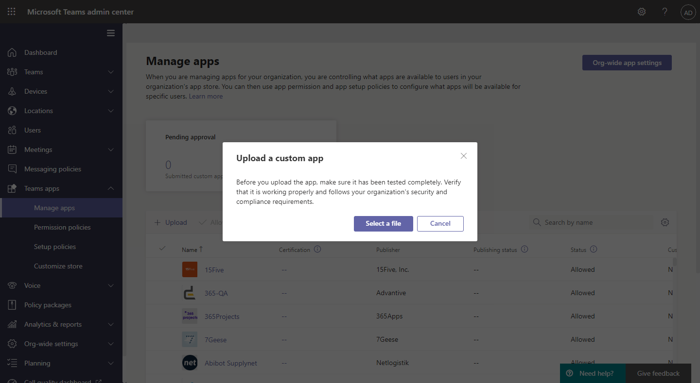

Slide 56
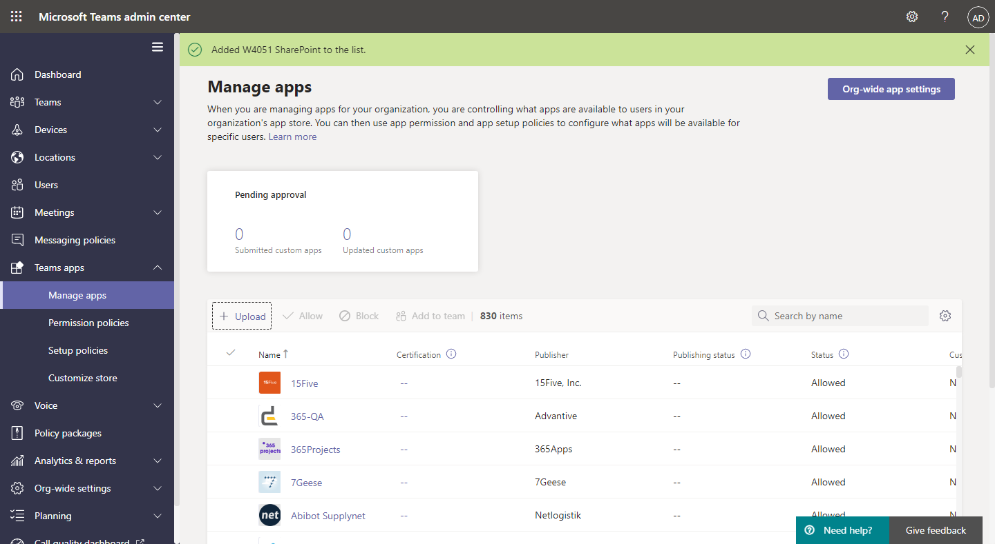

Slide 57
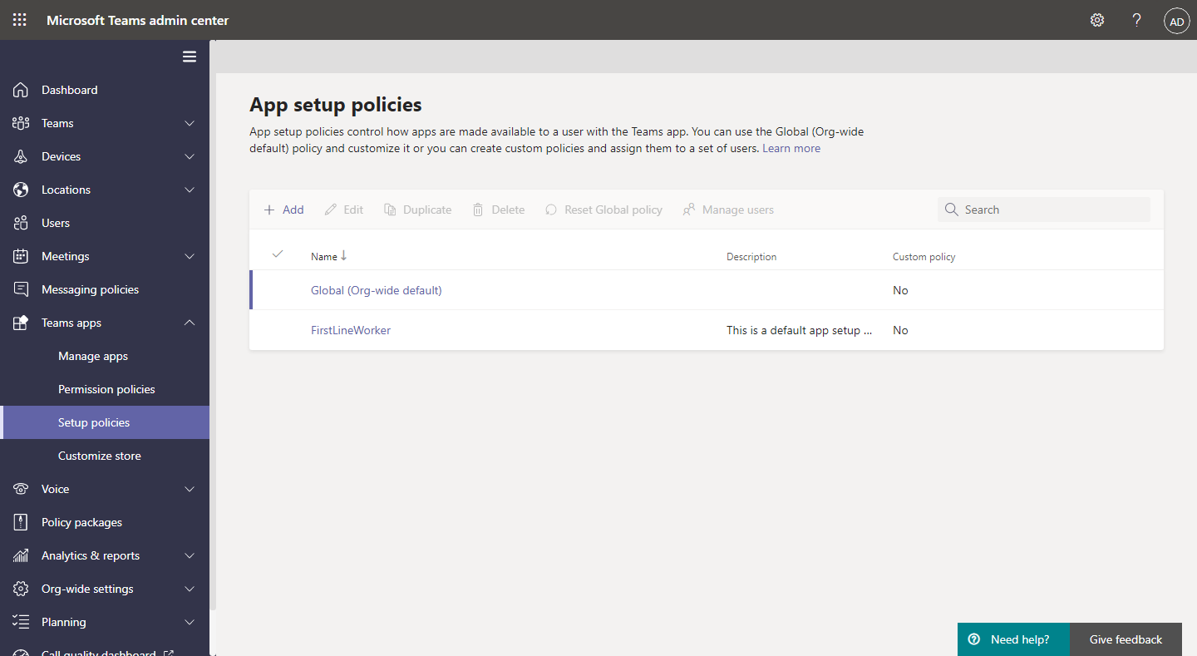

Slide 58
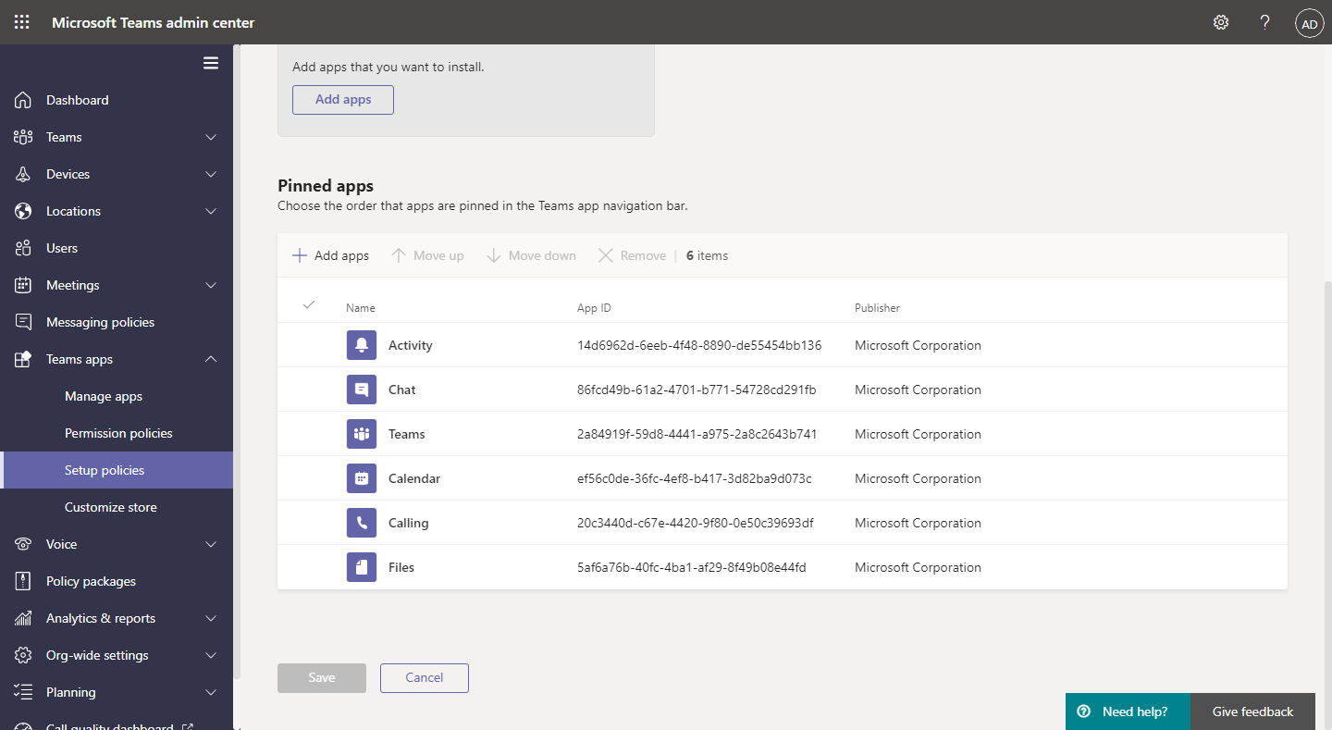

Slide 59
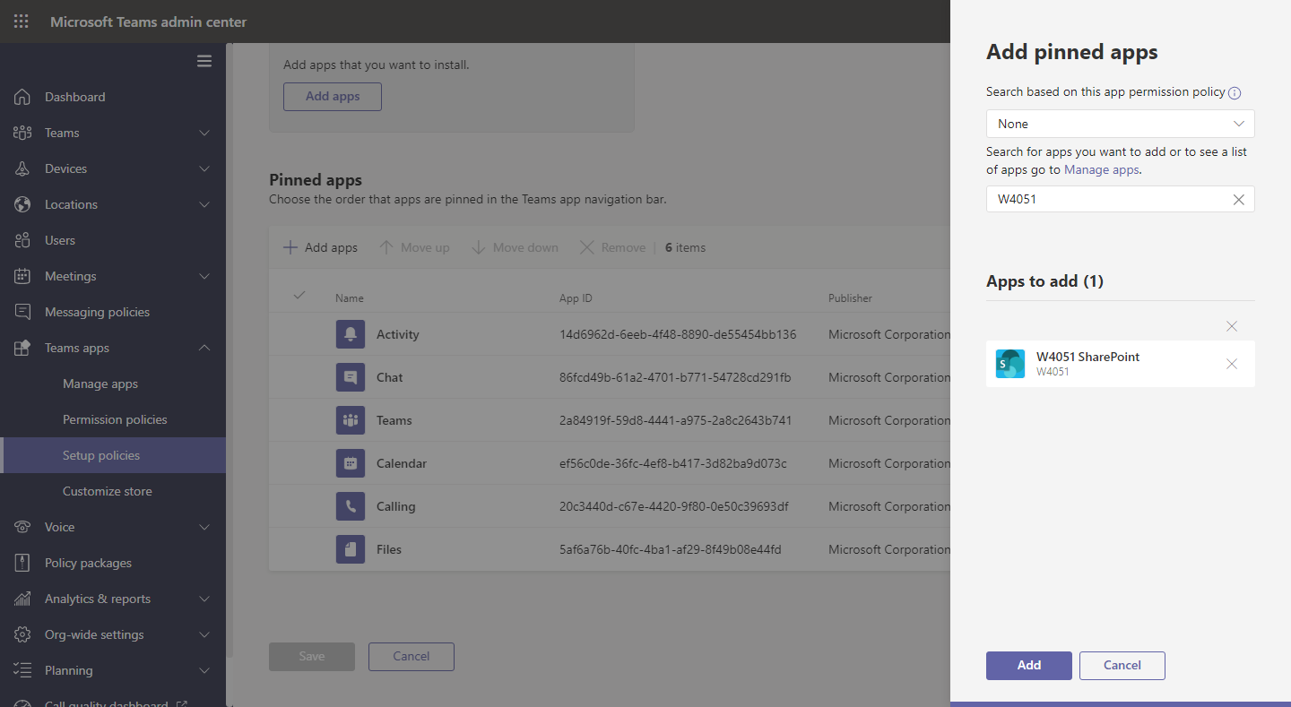

Slide 60
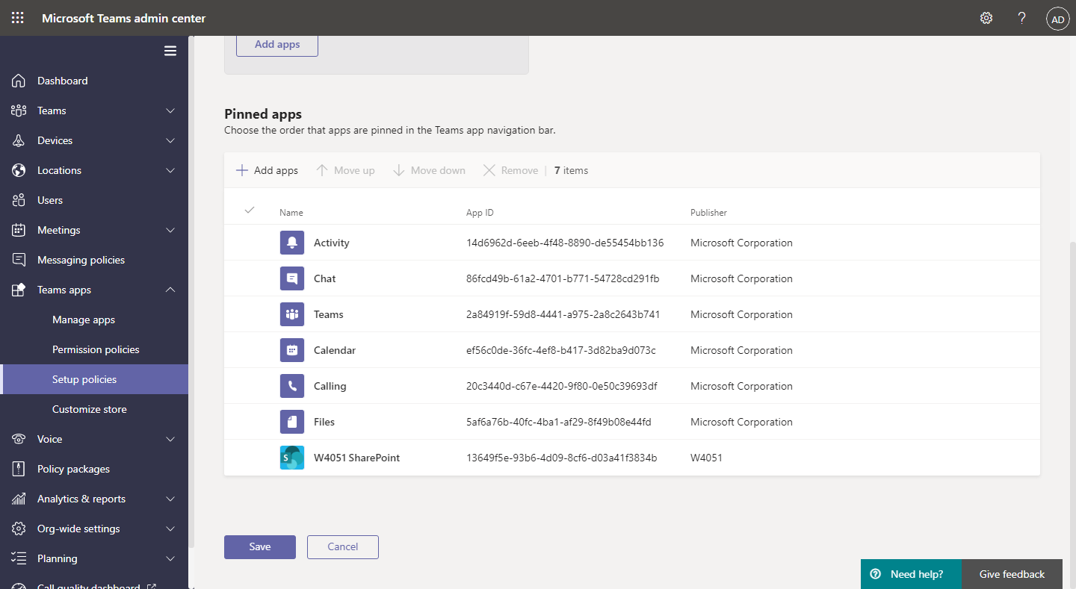

Slide 62
Not Just Modern Sites…
Despite what Microsoft say, classic sites also work using this method
Some websites also work
Must be https

Slide 63
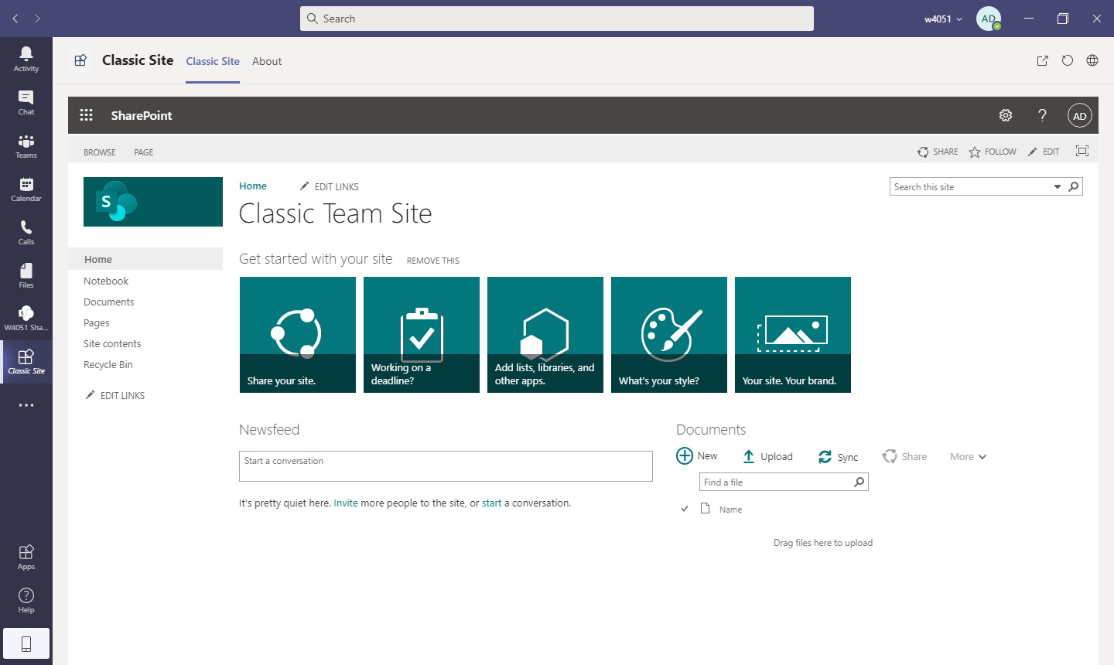

Slide 64
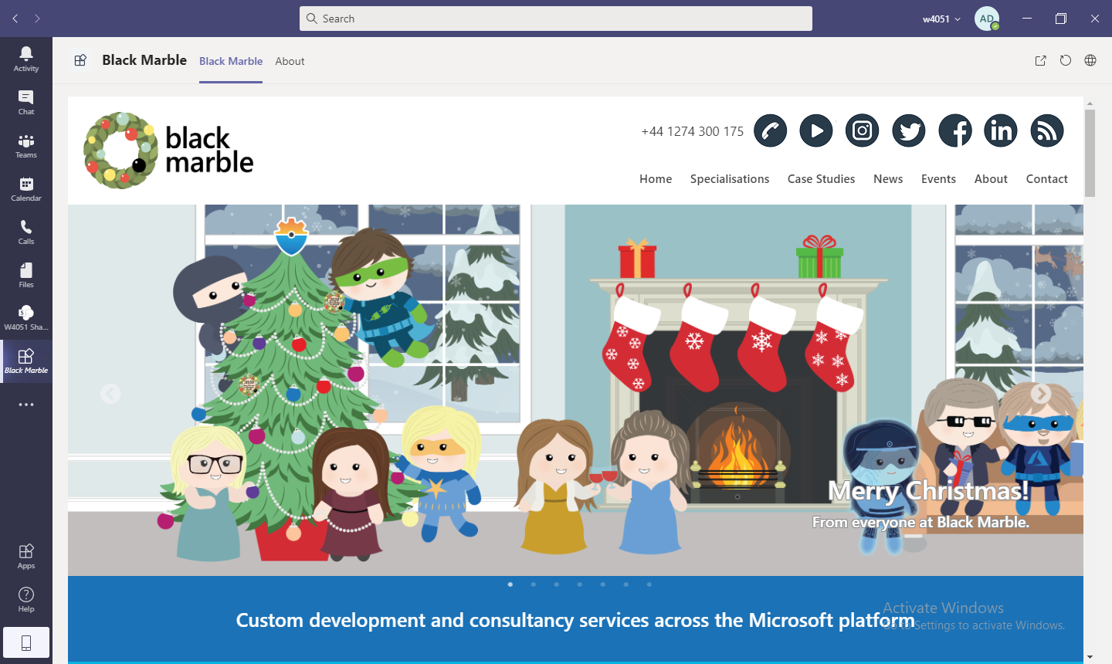

Slide 65
Recap
We’ve seen how to:
Create a published intranet in SharePoint Online
Add additional functionality (web part) using the samples that are available
Created an app in Teams to show the published intranet in Teams
Pinned this app to the sidebar in Teams to make it available to all

Slide 66
Andy Dawson
MVP (Office Apps and Services
@W4050
https://github.com/Andy-Dawson

